Slide 1
Automatic solar panel wet cleaning robot
BATCH MEMBERS :
1)G. THANUJA
2)P. MADHU VANDHINI
GUIDED BY :
Mrs. S.Pushpa (Assistant professor/EEE)

Slide 2
ABSTRACTION:
The dust that settles on solar panels from nearby pollution and traffic reduces the amount of sunlight that reaches the solar cells. Due to the presence of dust particles, the efficiency of solar panels decreases.
A solar energy monitoring system to collect and analyze solar energy characteristics for performance prediction and reliable power generation.
There is an LDR sensor, a relay unit, and a brush involved in this project.
Infrared sensors check for dust and activate an oscillating wiper to clear it away. Here, we are keeping an eye on the pv voltage. The GSM module and pic microcontroller in this PV monitoring system are responsible for sending out the warning signal.

Slide 3
CONTENT :
1)Introduction
2) Hardware components
3) Circuit diagram
4) Software requirements
5) Existing system
6) Proposed system
7) Block diagram
Hardware Circuit
8) Advantage
9) Disadvantage
10) Application
11) Result
12) Reference

Slide 4
INTRODUCTION:
Dust and other material that settles on the surface of photovoltaic (PV) panels reduces their efficiency.
Using commercial detergents to clean solar panels is not only inefficient, but can also damage the panels' frames and waste valuable time.
Maintaining maximum efficiency requires regular cleaning of solar panels, which can be challenging for big solar panel arrays.
The Internet of Things (IoT) is a rapidly developing technology that improves the functionality and usability of everyday objects when they are networked together using a common protocol and a cloud-based storage and processing system.
Thus, a real-time solar monitoring system is crucial for boosting PV panel performance.

Slide 5
HARDWARE COMPONENTS:
Power Supply
PIC Microcontroller
LDR – Light Dependent Resistor
LCD – Liquid Crystal Display
Solar Panel
Relay Board
IR – Infra Red Sensor
Voltage divider
DC motor
GSM – Global System for Mobile communication
Wiper and Water spraying mechanism

Slide 6
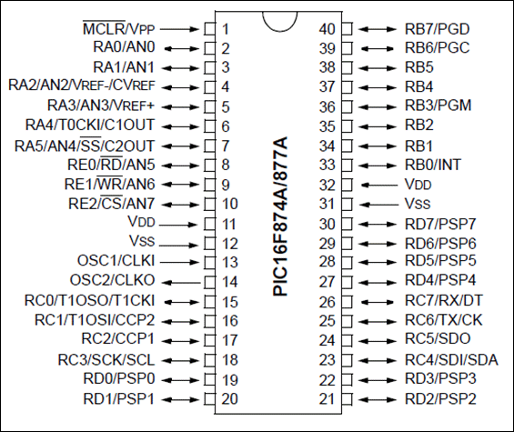
1. PIC microcontroller - PIC16F877A
PIC16F877a is a PIC Microcontroller and is normally used in Embedded Projects like Home Automation System, Bank Security System etc.
PIC16F877A has 40 pins by 33 paths of I/O.
The 40 pins make it easier to use the peripherals as the functions are spread out over the pins.
This makes it easier to decide what external devices to attach without worrying too much if there are enough pins to do the job.
One of the main advantages is that each pin is only shared between two or three functions so it’s easier to decide what the pin function (other devices have up to 5 functions for a pin).

Slide 7
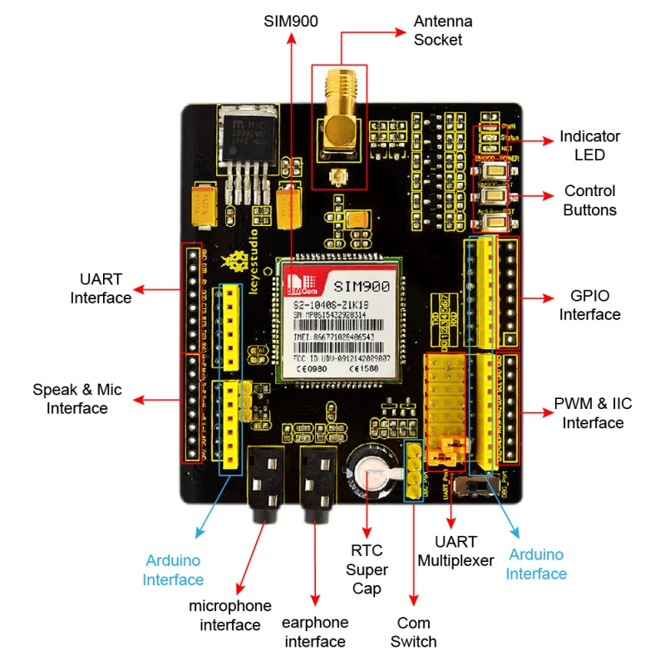
2. GSM MODULE – SIM900P
GSM is a mobile communication modem; it stands for global system for mobile communication (GSM). The idea of GSM was developed at Bell Laboratories in 1970.
It is a widely used mobile communication system in the world. GSM is an open and digital cellular technology used for transmitting mobile voice and data services operate at the 850MHz, 900MHz, 1800MHz, and 1900MHz frequency bands.
GSM technology was developed as a digital system using the time division multiple access (TDMA) technique for communication purposes. A GSM digitizes and reduces the data, then sends it down through a channel with two different streams of client data, each in its own particular time slot. The digital system has the ability to carry 64 kbps to 120 Mbps of data rates.

Slide 8
3. IR SENSOR – INFRA RED SENSOR:
An infrared sensor is an electronic device, that emits in order to sense some aspects of the surroundings.
An IR sensor can measure the heat of an object as well as detects the motion.
Usually in the infrared spectrum, all the objects radiate some form of thermal radiations.
These types of radiations are invisible to our eyes, that can be detected by an infrared sensor.
4 . SOLAR PANEL
A solar cell panel, solar electric panel, or solar panel, also known as a photo-voltaic (PV) module or PV panel, is an assembly of photovoltaic solar cells mounted in a (usually rectangular) frame. Solar panels capture sunlight as a source of radiant energy, which is converted into electric energy in the form of direct current (DC) electricity

Slide 9
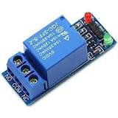
5. RELAY
A relay is an electrical switch that can be used to control devices and systems that use higher voltages. In the case of module relay, the mechanism is typically and electromagnet.
The relay module input voltage is usually DC. However, the electrical load that a relay will control can be either AC or DC, but essentially within the limit levels that the relay is designed for.
A relay module is available in an array of input voltage ratings: It can be a 3.2V or 5V relay module for low power switching, or it can be a 12 or 24V relay module for heavy-duty systems.
The relay module information is normally printed on the surface of the device for ready reference. This includes the input voltage rating, switch voltage, and current limit.

Slide 10
6. LCD – LIQUID CRYSTAL DISPLAY
LCD is a flat display technology, stands for "Liquid Crystal Display," which is generally used in computer monitors, instrument panels, cell phones, digital cameras, TVs, laptops, tablets, and calculators. It is a thin display device that offers support for large resolutions and better picture quality.
7 . VOLTAGE DIVIDER
A voltage divider is a simple circuit which turns a large voltage into a smaller one. Using just two series resistors and an input voltage, we can create an output voltage that is a fraction of the input. Voltage dividers are one of the most fundamental circuits in electronics.

Slide 11
8. DC MOTOR
A DC motor is any of a class of rotary electrical motors that converts direct current (DC) electrical energy into mechanical energy. The most common types rely on the forces produced by induced magnetic fields due to flowing current in the coil. Nearly all types of DC motors have some internal mechanism, either electromechanical or electronic, to periodically change the direction of current in part of the motor.
9. Wiper mechanism
Windshield wipers are operated by an electric motor. The electric motor is attached to a worm gear, which transmits the necessary force to a long rod that sets the wiper arms in motion. The worm gear is able to generate the force required to move the wipers as fast as they need to move.

Slide 12

10 . Power supply module
A power supply (sometimes known as a power supply unit or PSU) is a device or system
that supplies electrical or other types of energy to an output load or group of loads. The term is
most commonly applied to electrical energy supplies, less often to mechanical ones, and rarely
to others.

Slide 13
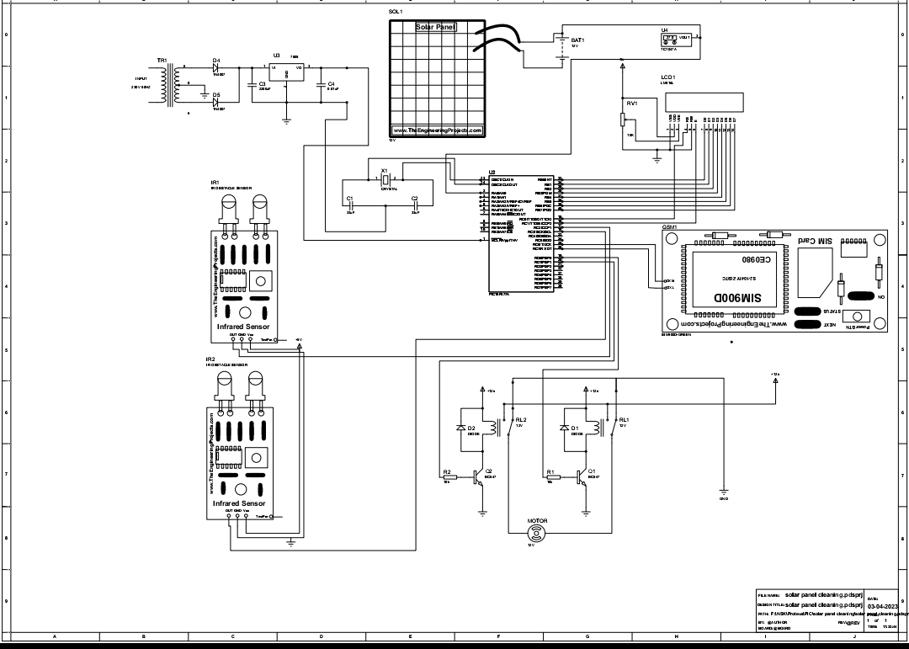
CIRCUIT DIAGRAM:

Slide 14
SOFTWARE REQUIREMENT:
MPLAB-IDE.
EMBEDDED C

Slide 15
EXISTING SYSTEM :
With the old setup, solar panel cleaning was done manually. The effectiveness of solar panels degrades for many reasons, including human mistake, bird faeces, dust, anddebris that accumulates on the panels' surfaces.
Moreover, solar panels are harmed since they are not regularly cleaned. Losses in the
system are also exacerbated by the fact that mechanically cleaning the solar panels causes wear and tear.
Also, the system efficiency is dropping, therefore it's not very efficient in terms ofenergy use.

Slide 16
PROPOSED METHOD :
The suggested system includes a PIC microcontroller, a solar panel, a light-dependent resistor,
a relay, an LCD display, and infrared (IR) technology.
The PIC microcontroller is the brains of this operation.
An LDR is used to determine whether day or night conditions currently exist
in the atmosphere.
A voltage divider and an analogue to digital converter are used to send data
from the LDR and the solar panel to the microcontroller.
Whereas an ADC takes an analogue voltage and converts it to a digital number proportional to its magnitude, a voltage divider is a passive linear circuit that creates an output value that is a fraction of its input voltage.

Slide 17
An infrared (IR) sensor is integrated into the system, automating the cleaning mechanism with properly shaped wipers, whose action covers the surface of the panels throughout the wiper's sweep cycle.
A motor drives the wiper in a wiper system, causing it to move horizontally across
the windscreen. While the solar panel charges the energy storage device during the day, that device provides electricity to the motor at night.
The panel's voltage is measured with the help of the voltage sensors. The efficiency of a solar PV module, For processing and transmission to the user via the GSM module, the microcontroller plays a crucial role in real-time monitoring and decision making.

Slide 18
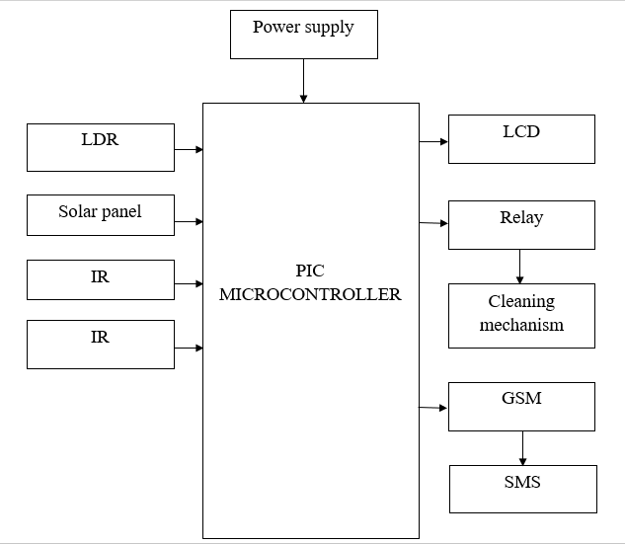
BLOCK DIAGRAM :

Slide 19
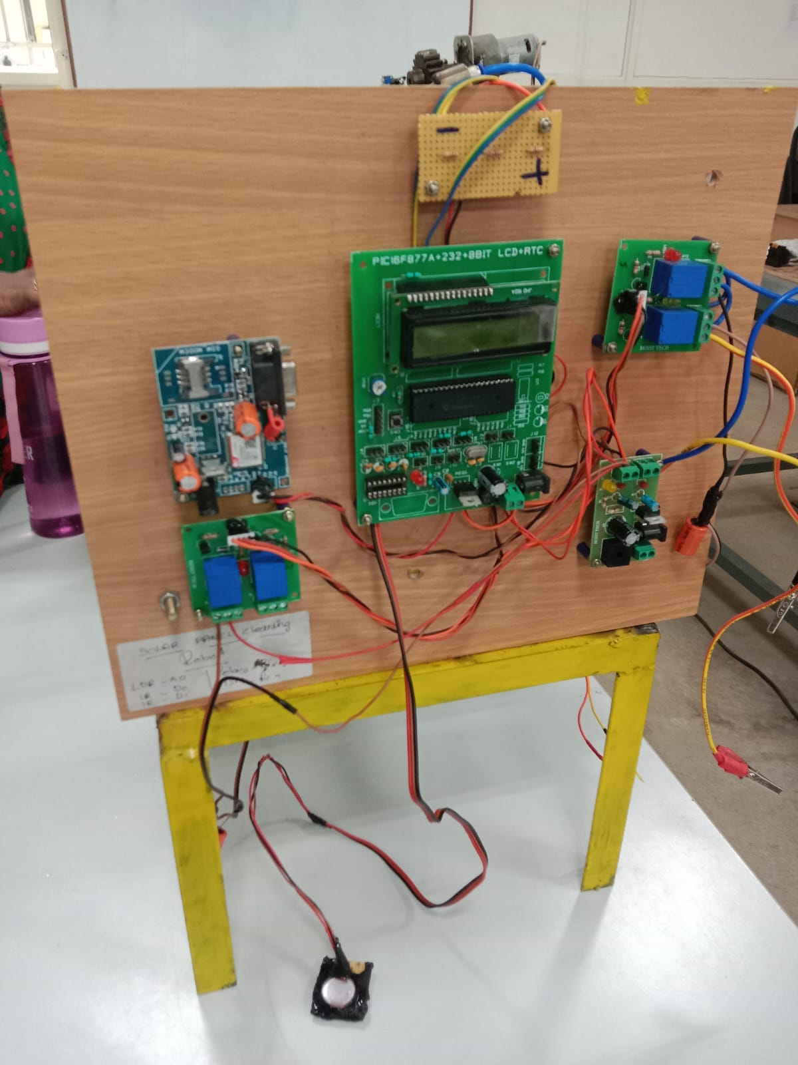
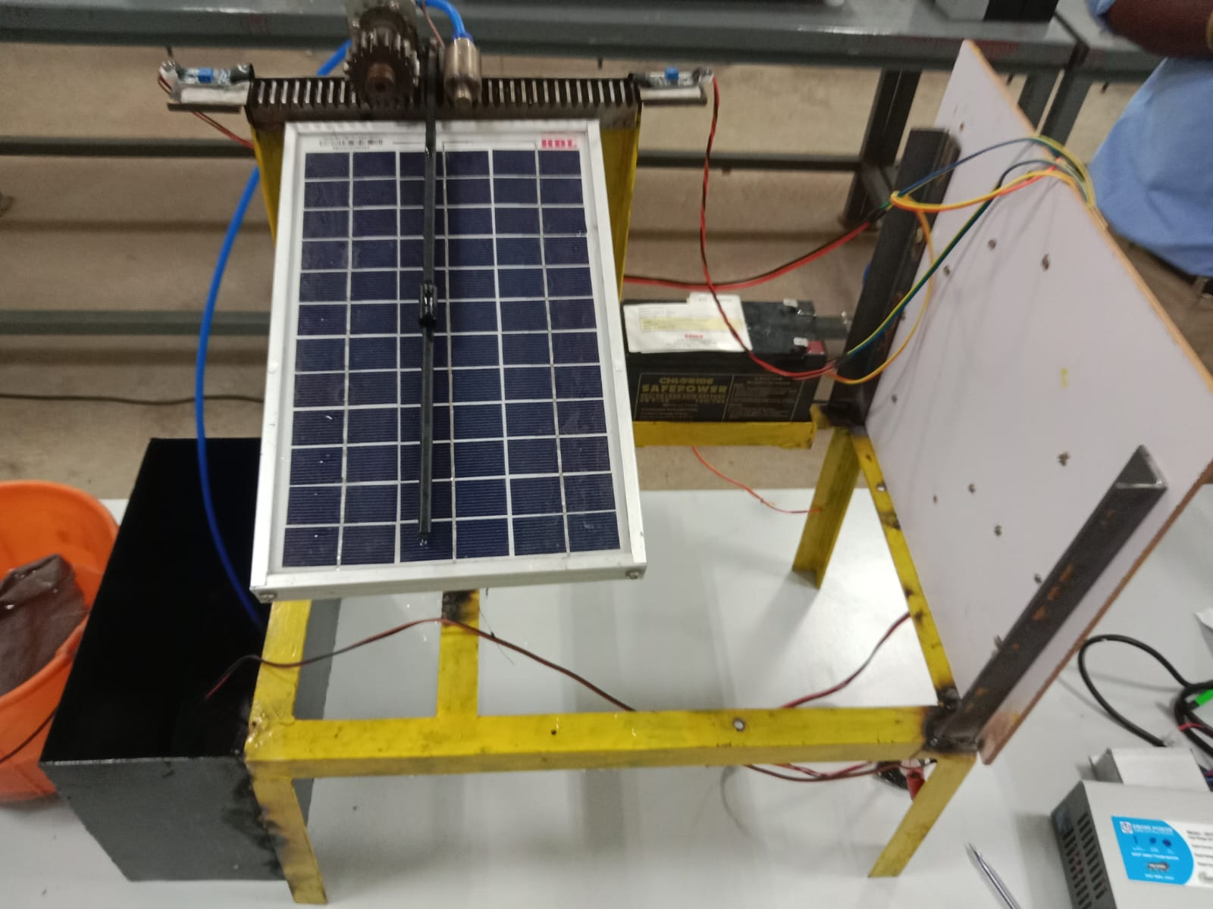
HARDWARE CIRCUIT :

Slide 20
ADVANTAGE:
Cleans the solar panel by using electro-mechanical shaft due to which solar panel cleaning will be done smoothly
This system is used for increase the efficiency of output & reduces the human effort.
Both wet and dry cleaning can be done effortlessly.

Slide 21
Disadvantage :
Commercial and Industrial Solar panel cleaning systems are challenging because they rarely have water and energy sources next to the solar panels.
They can be dangerous to clean since they may be on rooftops, carports or off the ground.
Initial cost has to be invested on the cleaning system along with the solar panel installation set-up.

Slide 22
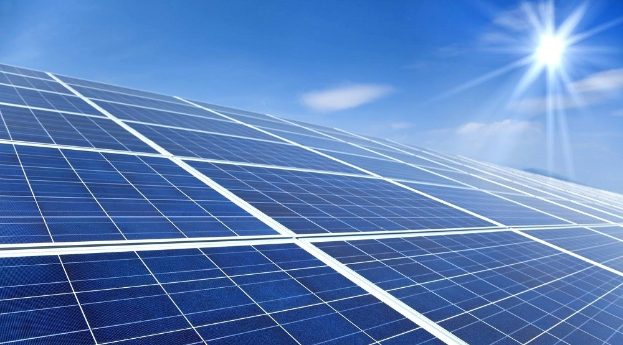
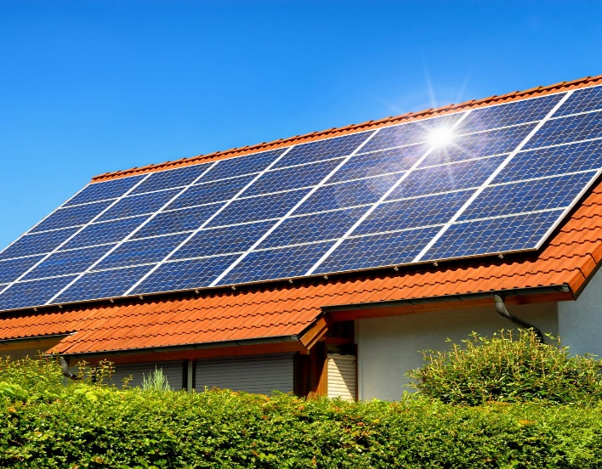
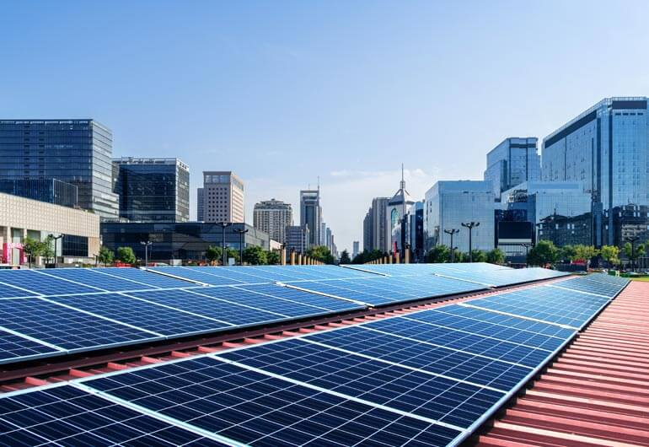
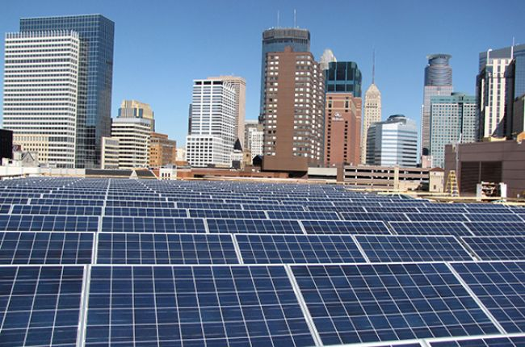
APPLICATION :
In solar power plants
In residencies that use solar panel.
In commercial area where array of solar panels are used.

Slide 23
RESULT :
The result shows that the developed solar panel cleaning robot is able to clean the panel effectively and increases back the output current as well as the maximum power of the panel by 50% after the cleaning of the solar panel.
This paper proposes a solar energy monitoring system to collect and analyse solar energy characteristics for performance prediction and reliable power generation.
Infrared sensors check for dust and activate an oscillating wiper to clear it way.

Slide 24
REFERENCE :
1. World Energy Outlook 2019, IEA, Paris, France, 2019.
2. Key World Energy Statistics, IEA, Paris, France, 2019.
3. Renewable Energy Options for the Industry Sector, IRENA, Abu Dhabi, United Arab Emirates, 2015.
4. Future of Solar Photovoltaic: Deployment, Investment, Technology, Grid Integration and Socio-Economic Aspects, IRENA, Abu Dhabi, United Arab Emirates, 2019.

Slide 25
THANK YOU !

